Slide 1
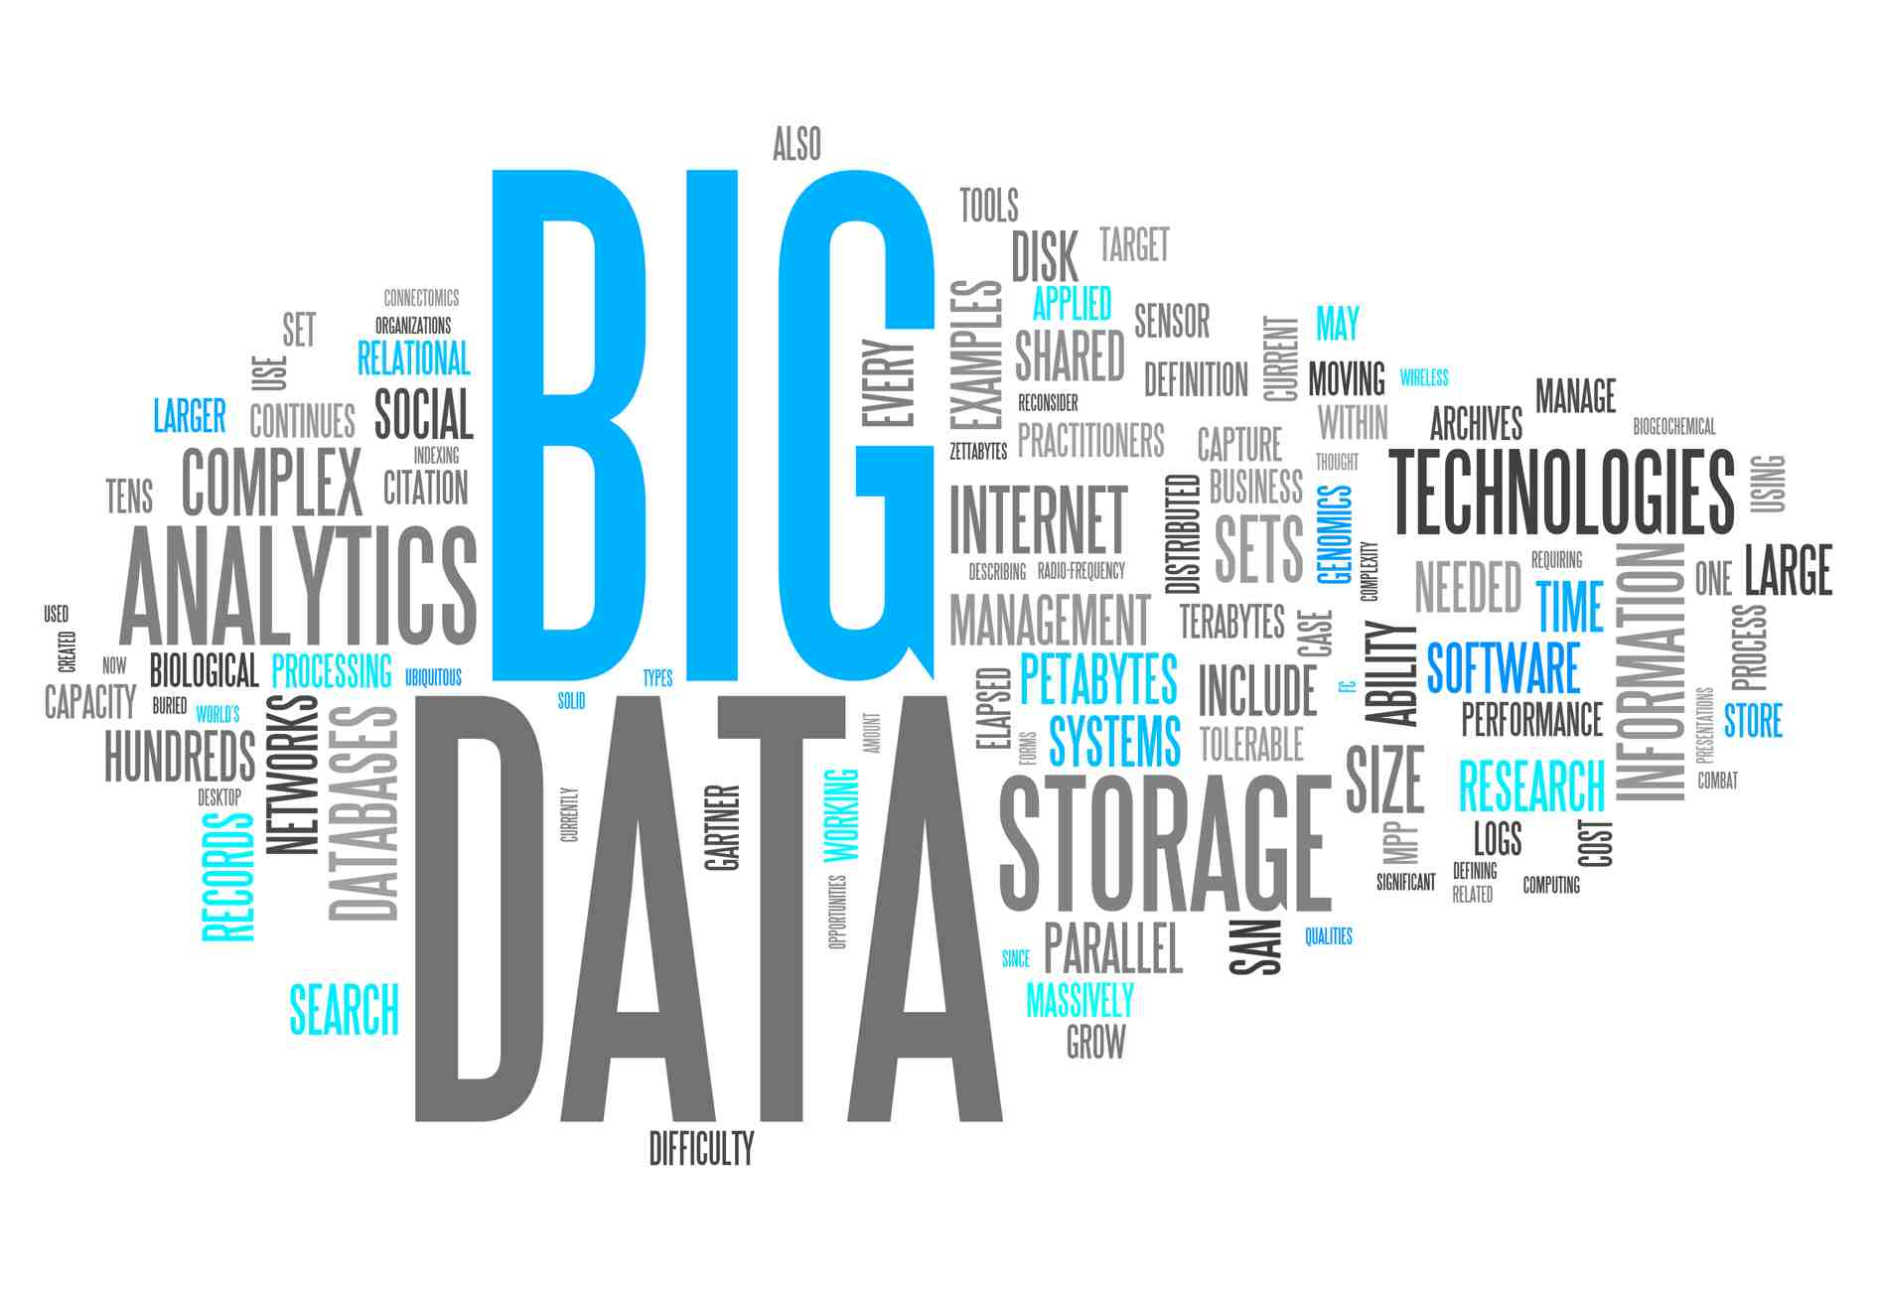
Big Data Science Clustering
Lesson #10

Slide 2
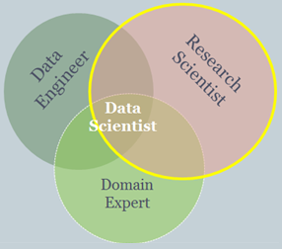
Data Science
Data
Hands On
Prepare Data
Learn
Evaluate
Monitor
Deploy
Business Goal

Slide 3
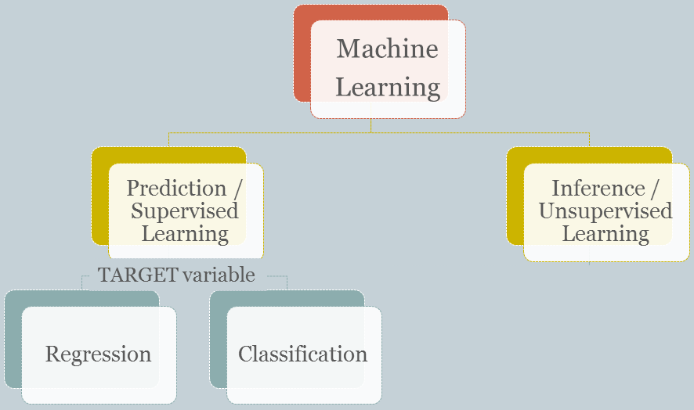
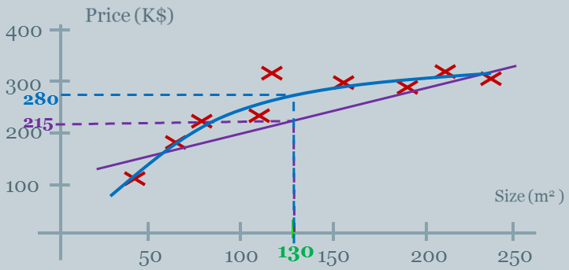
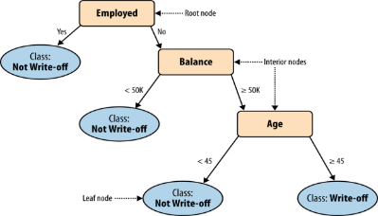
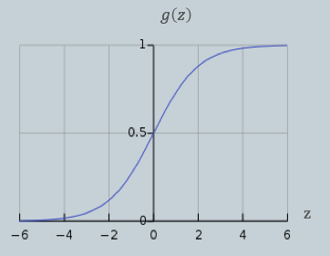
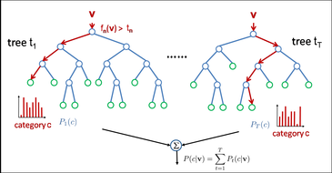
Learning Map

Slide 4
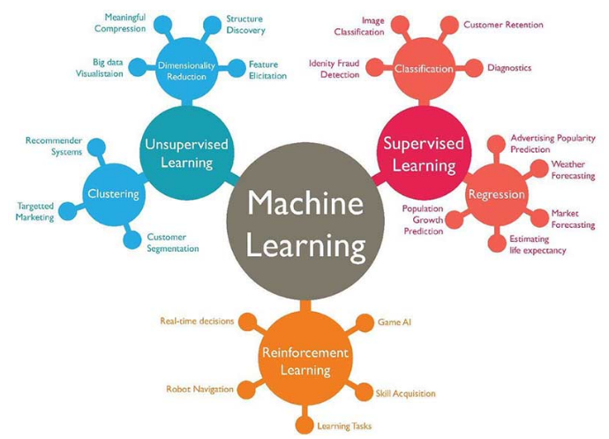
The Machine Learning Spectrum
http://www.techleer.com/articles/203-machine-learning-algorithm-backbone-of-emerging-technologies/

Slide 5
Agenda
What is Clustering?
Clustering Methods
K-Means Clustering
Hierarchical Clustering

Slide 6
Agenda
What is Clustering?
Clustering Methods
K-Means Clustering
Hierarchical Clustering

Slide 7
Classification Vs. Clustering Supervised Vs. Unsupervised Learning
Classification: Supervised learning:
Learns a method for predicting the instance class from pre-labeled (classified) instances

Slide 8
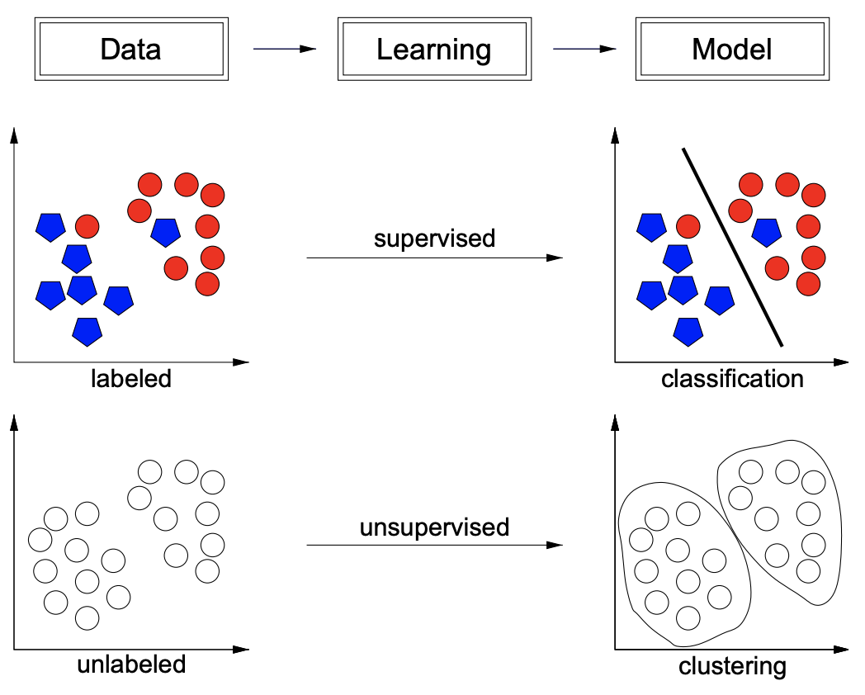
Classification Vs. Clustering Supervised Vs. Unsupervised Learning
http://researchers.lille.inria.fr/abellet/talks/metric_learning_tutorial_CIL.pdf

Slide 9
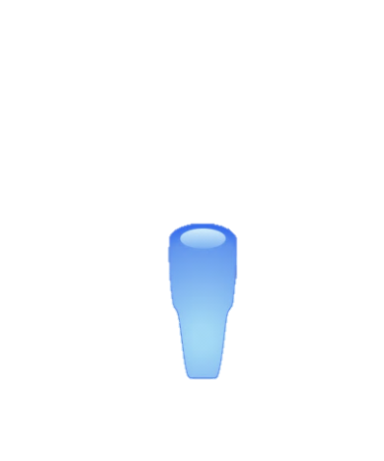
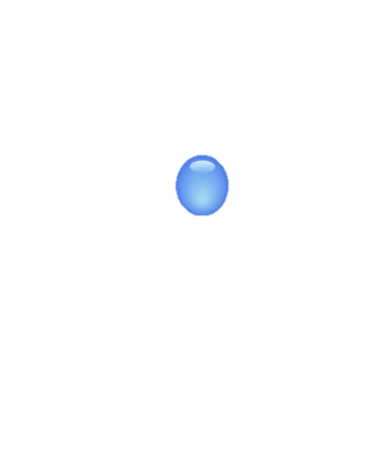


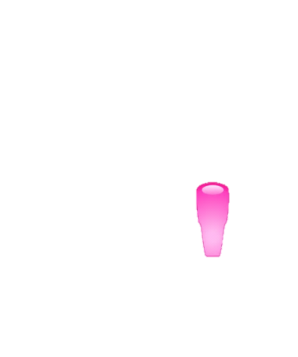

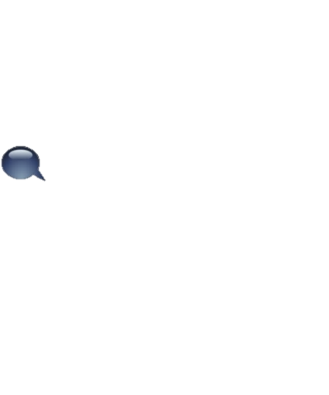
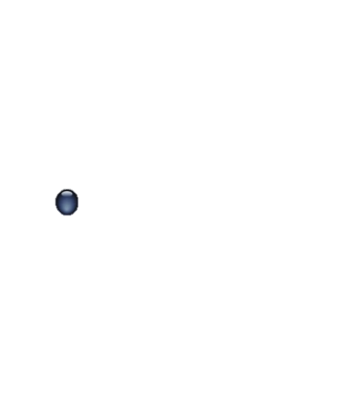
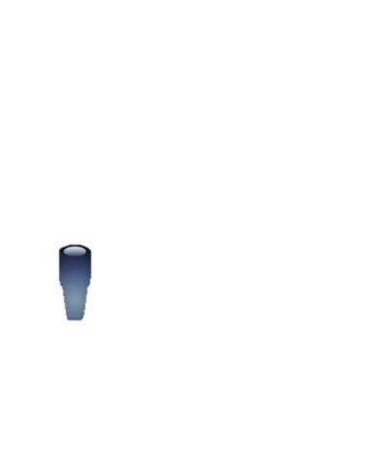
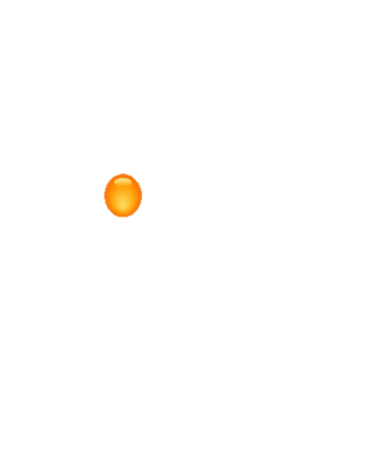
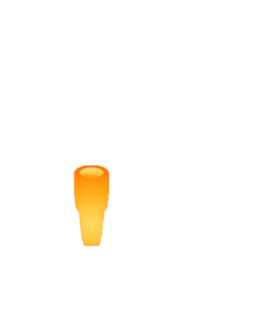




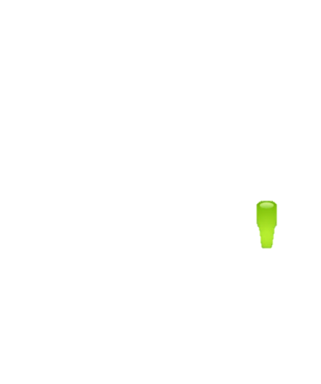
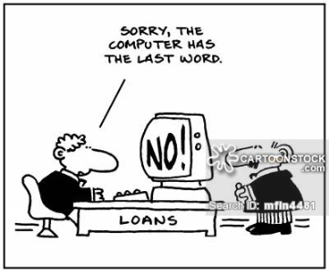
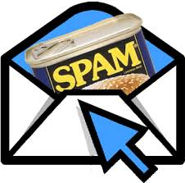
Machine Learning based Applications
Prediction /
Supervised Learning
Bill too
high
Pay Bill
Overage
3rd Party
Charges
Abnormal
Fee
Notes:
Clustering refers to a set of techniques for finding subgroups, or clusters, in a data set.

Slide 10
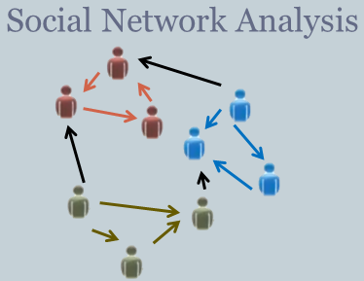
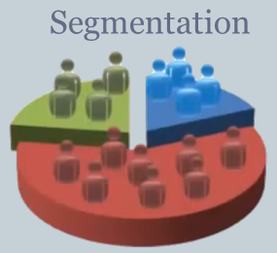
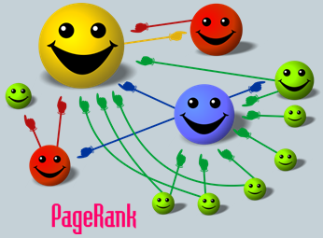
Machine Learning based Applications
Prediction /
Supervised Learning
Un-Supervised Learning
Bill too
high
Clustering
Pay Bill
Overage
3rd Party
Charges
Abnormal
Fee
Notes:
Clustering refers to a set of techniques for finding subgroups, or clusters, in a data set.

Slide 11
Machine Learning based Applications
Prediction /
Supervised Learning
Un-Supervised Learning
Un-Supervised Learning
Bill too
high
Clustering
Pay Bill
Overage
3rd Party
Charges
Abnormal
Fee
Notes:
Clustering refers to a set of techniques for finding subgroups, or clusters, in a data set.

Slide 12
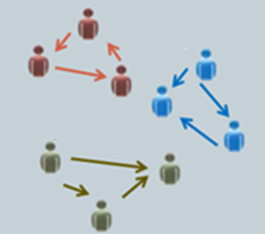
What is a Good Clustering?
A good clustering is one when
the objects within a group are similar
High intra-class similarity

Slide 13
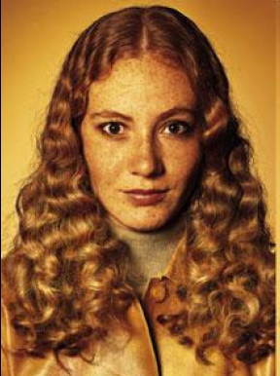
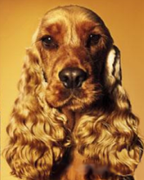
Similarity and Dissimilarity Between Objects
Clustering is about grouping similar objects together and dissimilar objects apart
But, how do we define similarity / dissimilarity ?
Similar object are ‘close’ to each other by some definition of distance

Slide 14
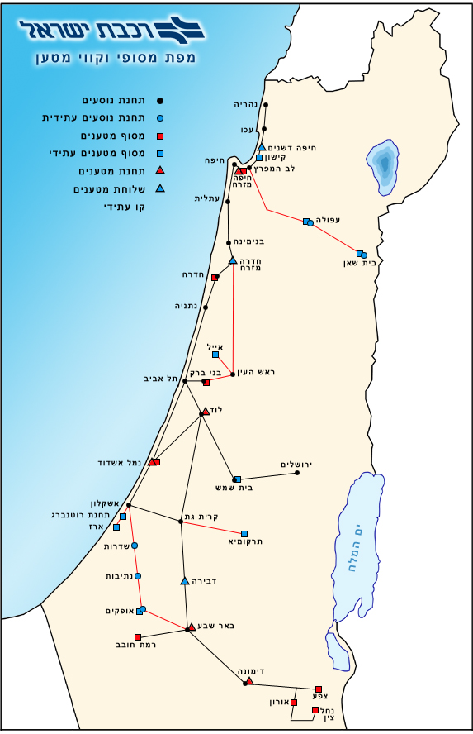
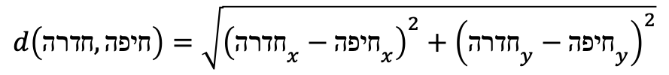
Similarity / Distance Metrics
L₂ Norm – Euclidean Distance
$$d\left(p,q\right)={\left\|p−q\right\|}_{2}=\sqrt{{\left(p_{1}−q_{1}\right)}^{2}+{\left(p_{2}−q_{2}\right)}^{2}+…+{\left(p_{n}−q_{n}\right)}^{2}}$$
Y
$$d\left(חדרה,חיפה\right)=\sqrt{{\left({חדרה}_{x}−{חיפה}_{x}\right)}^{2}+{\left({חדרה}_{y}−{חיפה}_{y}\right)}^{2}}$$
X

Slide 15

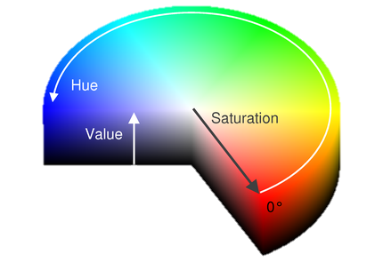


Similarity / Distance Metrics
Distance is defined over the features space

Slide 16
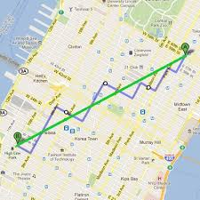
L₁ Norm – Manhattan Distance

Slide 17
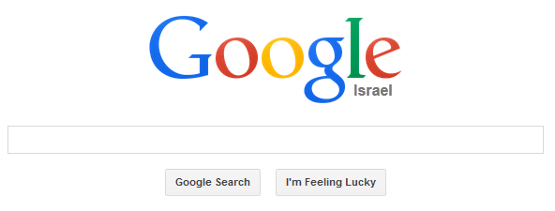
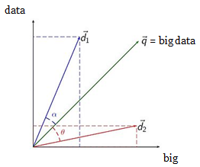
Similarity / Distance Metrics Information Retrieval
Vector Space Model

Slide 18
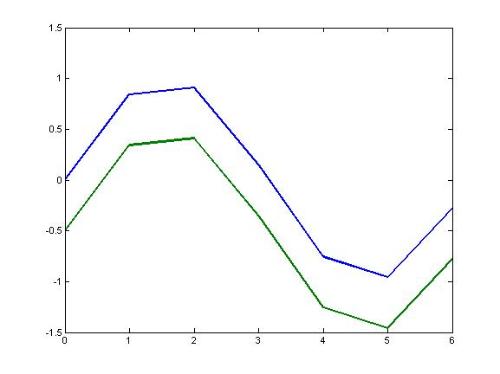
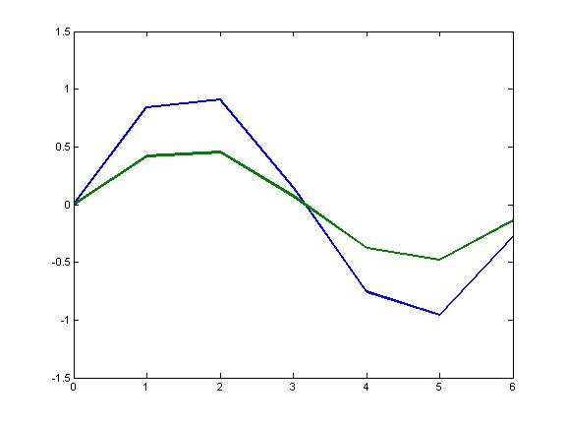
Correlation
Notes:
We might care more about the overall shape of feature profiles rather than the actual magnitudes
That is, we might want to consider features similar when they are “up” and “down” together
When might we want this kind of measure? What experimental issues might make this appropriate?

Slide 19
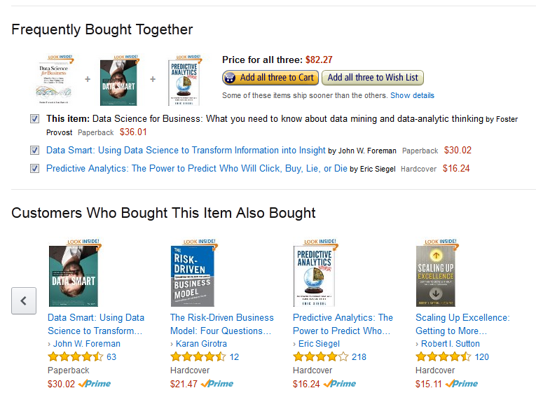
Recommendations
Collaborative Filtering
Jaccard Similarity

Slide 20
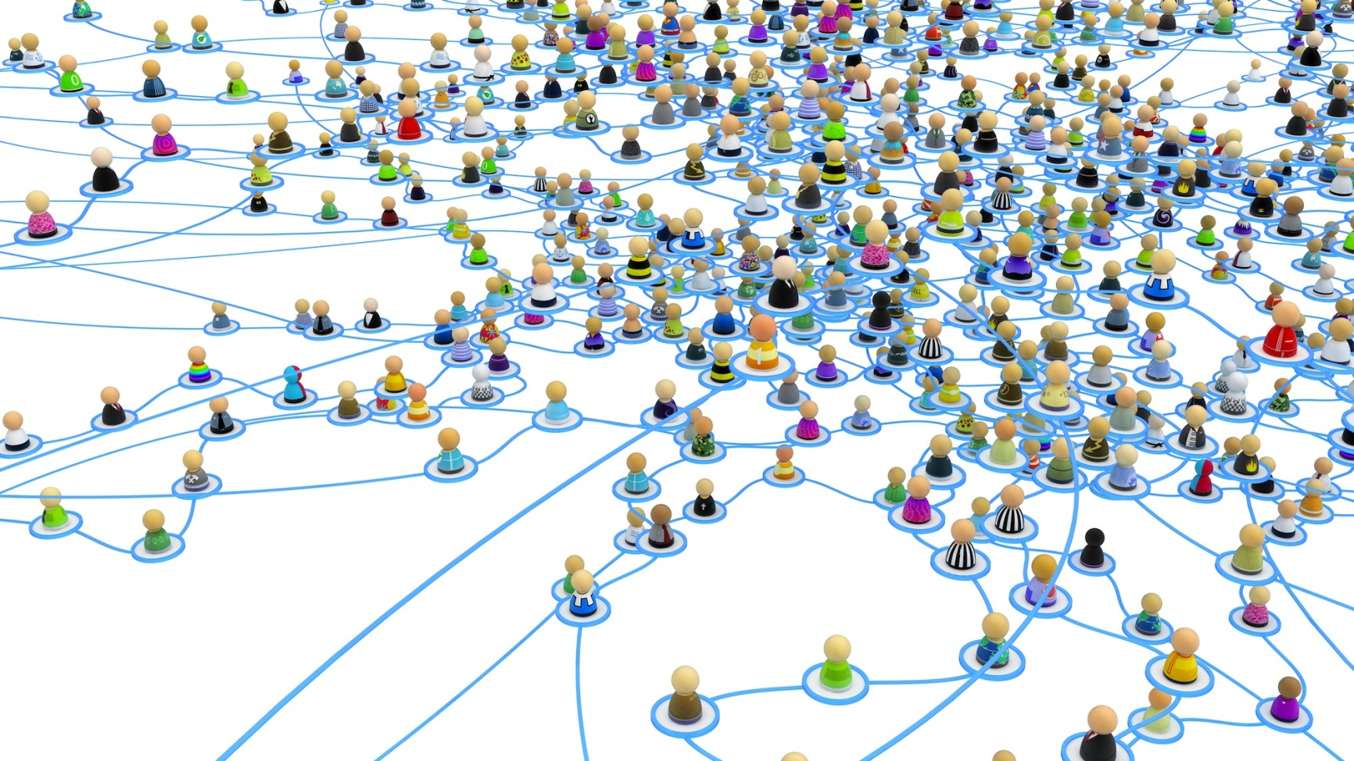
Social Similarity
Propose a similarity metric

Slide 21
The inherent problem with Unsupervised Learning
Precise definition of clustering quality is difficult
Application-dependent
Ultimately subjective

Slide 22
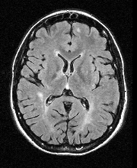
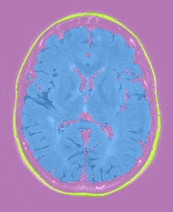
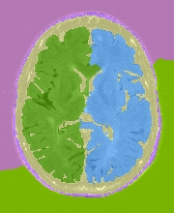
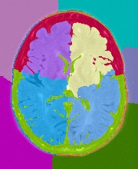
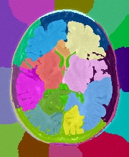
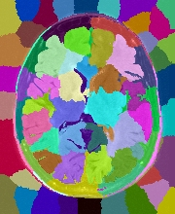
Image Segmentation

Slide 23
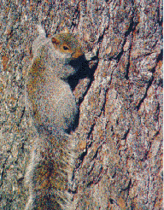
Image Segmentation is Hard
Camouflage
Ronen Basri et.al Weizmann Institute

Slide 24
Agenda
What is Clustering?
Clustering Methods
K-Means Clustering
Hierarchical Clustering

Slide 25
Different Clustering Methods
There are many different types of clustering methods
We will concentrate on two of the most commonly used approaches
Partitioning based methods - K-Means Clustering
Hierarchical Clustering

Slide 26
K-Means clustering

Slide 27
K-means example, step 1
k₁
Y
Pick K=3
initial
cluster
centers
(randomly)
k₂
k₃
X

Slide 28
K-means example, step 2
k₁
Y
k₂
Assign
each point
to the closest
cluster
center
k₃
X

Slide 29
K-means example, step 3
k₁
k₁
k₁
Y
Move
each cluster center
to the mean
of each cluster
k₂
k₂
k₃
k₂
k₃
k₃
X

Slide 30
K-means example, step 4
Reassign
points
closest to a different new cluster center
Q: Which points are reassigned?
k₁
Y
k₃
k₂
X

Slide 31
K-means example, step 4 …
Reassign
points
closest to a different new cluster center
Q: Which points are reassigned?
k₁
Y
k₃
k₂
X

Slide 32
K-means example, step 4b
k₁
Y
re-compute cluster means
k₃
k₂
X

Slide 33
K-means example, step 5
k₁
Y
k₂
move cluster centers to cluster means
k₃
Continue until centers don’t move anymore
X

Slide 34
K-Means – Pros & Cons
Pros
Extremely simple algorithm
Relatively efficient – complexity?

Slide 35
K-Means – Complexity
Review K-Means Algorithm – Simple as that:
Initialize cluster centroids (centers)
Repeat until convergence
Assign each point to the closest cluster centroid
Re-compute clusters’ centers
Complexity
O(t·k·n)
Normally, k, t << n.
➔ O(n)
O(1)
t times
O(k·n)
O(n)

Slide 36
K-Means – Pros & Cons
Pros
Extremely simple algorithm
Relatively efficient – complexity O(n)
Has an objective function to optimize.

Slide 37
K-Means Objective Function
A good clustering is one when
the observations within a group are similar
High intra-class similarity

Slide 38
Intra-Cluster Distance
Distances within (intra) a cluster
Could be calculated in several ways:
the distance between the farthest two points inside a cluster
the mean of all pairwise distances between data points inside a cluster
the mean distance of all data points from the cluster centroid
Y
X

Slide 39
K-Means Objective Function
A good clustering is one when
the observations within a group are similar
High intra-class similarity
the observations between groups are very different
Low inter-class similarity

Slide 40
Inter-Cluster Distance
Distances between (inter) clusters
Could be calculated in several ways:
the distance between the closest/furthest two points, one in each cluster
the distance between clusters’ centroids
Y
X

Slide 41
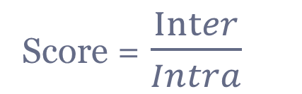
K-Means Objective
Putting it all together, we want K-Means to:
Maximize Between (Inter) clusters distances
Minimize Within (Intra) clusters distances
Score =$\frac{Inter}{Intra}$

Slide 42
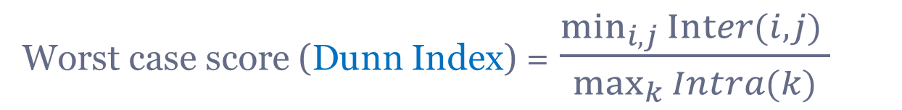
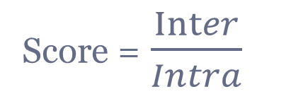
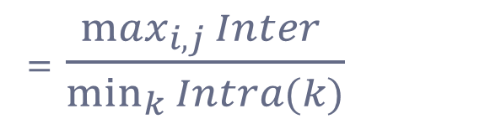
K-Means Evaluation
Score =$\frac{Inter}{Intra}$
Worst case score (Dunn Index) =$\frac{\min_{i,j}{Inter(i,j)} }{\max_{k}{Intra(k)}}$
=$\frac{\max_{i,j}{Inter} }{\min_{k}{Intra(k)}}$
Best case score =
?
Other two well known metrics: Silhouette & Davies-Bouldin

Slide 43
K-Means – Pros & Cons
Pros
Extremely simple algorithm
Relatively efficient – complexity O(n)
Has an objective function to optimize.
However, often it terminates at a local optimum. The global optimum may be found using techniques such as simulated annealing and genetic algorithms

Slide 44
Local Optimum
Bad Solution
Good Solution
The K-means algorithm can find only “local optimum” and not the best solution
Hence, it is important to run the algorithm multiple times with random starting points to (hopefully) find the best solution
Introduction to Statistical Learning / Tibshirani et al
Notes:
Taken from the ISLR book of the course: K-means clustering performed six times on the data from Figure
10.5 with K = 3, each time with a different random assignment of the observations
in Step 1 of the K-means algorithm. Above each plot is the value of
the objective (10.11). Three different local optima were obtained, one of which
resulted in a smaller value of the objective and provides better separation between
the clusters. Those labeled in red all achieved the same best solution, with an
objective value of 235.8.

Slide 45
K-Means – Pros & Cons
Pros
Extremely simple algorithm
Relatively efficient – complexity O(n)
Has an objective function to optimize.
However, often it terminates at a local optimum. The global optimum may be found using techniques such as simulated annealing and genetic algorithms
Cons
Need to specify k, the number of clusters, in advance

Slide 46
K-Means Clustering
raw (k=1)

Slide 47
K-Means – Pros & Cons
Pros
Extremely simple algorithm
Relatively efficient – complexity O(n)
Has an objective function to optimize.
However, often it terminates at a local optimum. The global optimum may be found using techniques such as simulated annealing and genetic algorithms
Cons
Need to specify k, the number of clusters, in advance
Trouble with noisy data and outliers

Slide 48
K-means - outliers
k₁
Y
k₂
move cluster centers to cluster means
k₃
X

Slide 49
Solution – K- Means Medoids
Use centers by Median and not Mean
k₁
Y
k₂
k₃
X

Slide 50
K-Means – Pros & Cons
Pros
Extremely simple algorithm
Relatively efficient – complexity O(n)
Has an objective function to optimize.
However, often it terminates at a local optimum. The global optimum may be found using techniques such as simulated annealing and genetic algorithms
Cons
Need to specify k, the number of clusters, in advance
Trouble with noisy data and outliers
Not suitable to discover clusters with non-convex data

Slide 51
K-Means fails on non-convex data

Slide 52
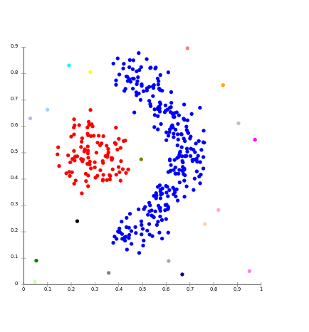
Non-Convex Data

Slide 53
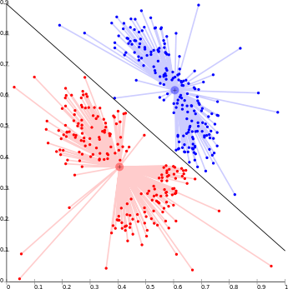
K-Means on Non-Convex data
That’s why K-means is not used in image processing

Slide 54
K-Means – Pros & Cons
Pros
Extremely simple algorithm
Relatively efficient – complexity O(n)
Has an objective function to optimize.
However, often it terminates at a local optimum. The global optimum may be found using techniques such as simulated annealing and genetic algorithms
Cons
Need to specify k, the number of clusters, in advance
Trouble with noisy data and outliers
Not suitable to discover clusters with non-convex data
Can’t visualize for dimensions > 2

Slide 55
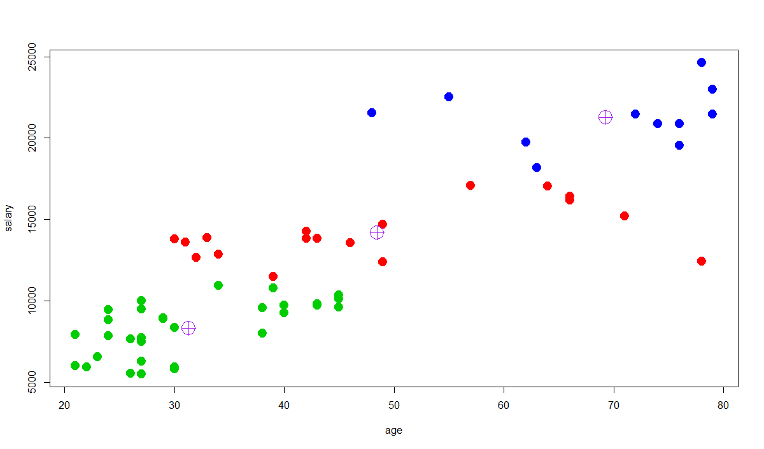
One last note before moving on
What’s wrong with the following K-Means result ?
age=69
salary = 21260
age=48
salary = 14180
6292
832
age=71
salary = 15000

Slide 56
Scaling
Since clustering is based on calculating distances
➔ If data points mix different features with different scales we need to scale our data beforehand
$$d\left(p,q\right)={\left\|p−q\right\|}_{2}=\sqrt{{\left(p_{1}−q_{1}\right)}^{2}+{\left(p_{2}−q_{2}\right)}^{2}+…+{\left(p_{n}−q_{n}\right)}^{2}}$$

Slide 57
Agenda
What is Clustering?
Clustering Methods
K-Means Clustering
Hierarchical Clustering

Slide 58
Hierarchical clustering

Slide 59


Hierarchical Clustering
Dendrogram

Slide 60




Hierarchical Clustering by Example
data matrix
features
distance matrix
Euclidean distance

Slide 61




Hierarchical Clustering by Example
Merge two closest clusters (iteration 1)

Slide 62




Hierarchical Clustering by Example
Update distance matrix (iteration 1)
Linkage

Slide 63



Hierarchical Clustering by Example
Merge two closest clusters (iteration 2)

Slide 64



Hierarchical Clustering by Example
Update distance matrix (iteration 2)

Slide 65




Hierarchical Clustering by Example
Merge two closest clusters/update distance matrix (iteration 3)

Slide 66




Hierarchical Clustering by Example
Merge two closest clusters/update distance matrix (iteration 4)

Slide 67

Hierarchical Clustering by Example
Final result

Slide 68

Hierarchical Clustering by Example
Dendrogram tree representation
In the beginning we have 6
clusters: A, B, C, D, E and F
We merge clusters D and F into
cluster (D, F) at distance 0.50
We merge cluster A and cluster B
into (A, B) at distance 0.71
We merge clusters E and (D, F)
into ((D, F), E) at distance 1.00
We merge clusters ((D, F), E) and C
into (((D, F), E), C) at distance 1.41
We merge clusters (((D, F), E), C)
and (A, B) into ((((D, F), E), C), (A, B))
at distance 2.50
The last cluster contain all the objects,
thus conclude the computation
6
lifetime
5
4
3
2
object
Notes:
For a dendrogram tree, its horizontal axis indexes all objects in a given data set, while its vertical axis expresses the lifetime of all possible cluster formation.
The lifetime of a cluster in the dendrogram is defined as a distance interval from the moment that the cluster is created to the moment that it disappears by merging with other clusters.

Slide 69
Choosing Clusters
To choose clusters we cut the dendrogram in a specific height
We can form any number of clusters depending on the cut height
One Cluster
Two Clusters
Three Clusters

Slide 70
Linkage in Hierarchical Clustering
We already know about distance measures between data items, but what about between a data item and a cluster or between two clusters?
We just treat a data point as a cluster with a single item, so our only problem is to define a linkage method between clusters
As usual, there are lots of choices…

Slide 71
Single Linkage
The minimum of all pairwise distances between points in the two clusters
Tends to produce long, “loose” clusters

Slide 72
Single Link Example

Slide 73
Complete Linkage
The maximum of all pairwise distances between points in the two clusters
Tends to break large clusters

Slide 74
Complete Link Example

Slide 75
Average Linkage
The average of all pairwise distances between points in the two clusters
Note! It’s not the distance between the clusters’ means - Centroid Linkage
Tends to produce evenly sized clusters

Slide 76
Linkage All Together
Complete and average linkage tend to yield evenly sized clusters whereas single linkage tends to yield extended clusters to which single leaves are fused one by one.

Slide 77
Hierarchical Clustering - Pros & Cons
Pros
Do not have to assume any particular number of clusters
Just cut the tree
Hierarchy is important for some apps

Slide 78







Hierarchical Clustering Apps
Build a tree-based hierarchical taxonomy (dendrogram) from a set of documents
animal
vertebrate
invertebrate
fish reptile amphib. mammal worm insect crustacean
How could you do this with k-means?

Slide 79


Web Directory

Slide 80

Curlie Web Directory

Slide 81

Telecom’s Word Cloud

Slide 82


Clusters by Exploring Dendrograms

Slide 83



Clusters

Slide 84
Image Segmentation

Slide 85
Hierarchical Clustering - Pros & Cons
Pros
Do not have to assume any particular number of clusters
Just cut the tree
Hierarchy is important for some apps
In contrast to K-Means, can be nicely visualized, independent of dimensionality
Cons
Complexity:
Space - O(N²) – distance matrix
Time – O(N³) – Merge all points – each time update dist. Matrix
Difficulty in handling different size of clusters

Slide 86

DBSCAN
https://towardsdatascience.com/the-5-clustering-algorithms-data-scientists-need-to-know-a36d136ef68

Slide 87


Summary

Slide 88


Clustering Methods (two well known out of many)
K-Means
Hierarchical

Slide 89

That was really fun!

